Slide 1
GLA Pre-Procedural COVID Testing: Outpatient Workflow
*Preprocedure lab is performed via NARES swab and run at WLA as CEPHEID
(See page 2 for screenshots)
Previously COVID (+)
Repeat testing NOT indicated if diagnosis was within prior 90 days
>20 days from 1st (+) with resp. improvement AND 24hrs afebrile w/o antipyretics
≤20 days OR >20 days from 1st (+) w/o resp. improvement and/or still febrile
Weigh risks and benefits; pt still infectious
PROCEED-- Patient clinically resolved
Providers wear STANDARD PPE
STANDARD cleaning (post procedure)
If proceeds: Providers wear ENHANCED PPE
TERMINAL Cleaning (post procedure)
Patient treated for COVID-19 as an OUTPATIENT
Patient treated for COVID-19 as an INPATIENT
PROCEED if >10 days from 1st (+) AND resp. improvement AND 24hrs afebrile w/o antipyretics
If ≤ 10 days or without resp. improvement and afebrile, weigh risks/benefits
Previously COVID (-) or Unknown
PROVIDER orders COVID-19 *PREPROCEDURE Lab
PROVIDER reviews test result
COVID-19 negative
Proceed
COVID-19 positive
Proceed as indicated; reschedule non-urgent cases
(MSA schedules from procedure RTC/consult)
MSA schedules patient into testing grid 1-3 days prior to procedure**
Current clinic/CBOC sites for M-F testing: SACC, LAACC, SB, BAK, OXN, SAM, SLO, LAN
WLA “Wla-Preop Screening Tent” hours M-Sat 0800-1530
**If 1-3 days prior is not possible, order CEPHEID RT-PCR (Change to Nares) for “STAT” same day results

Slide 2
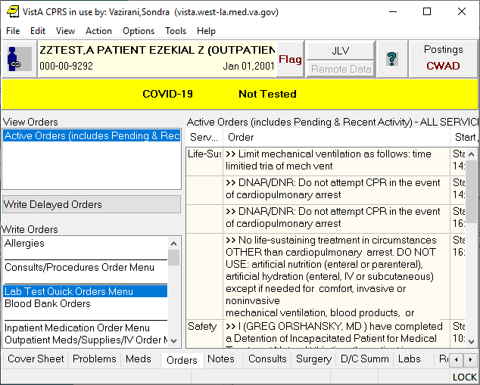
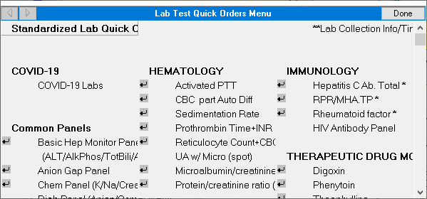
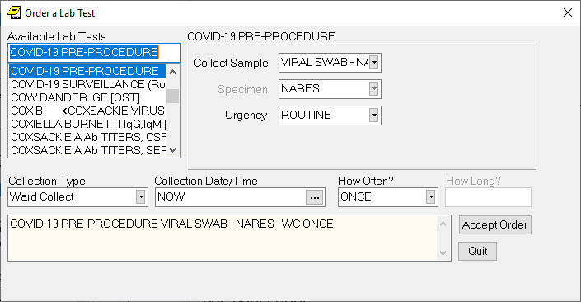
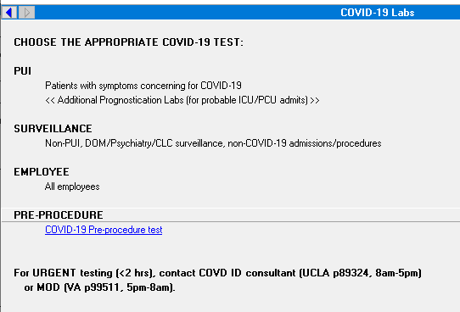
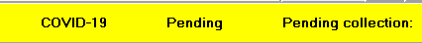
Screenshots for pre-procedure COVID test orders
2
1
Leave collection Date/Time as “NOW” and Accept Order/Sign
4
3
Once ordered, the above banner will show for up to 7 days with the “Pending Collection” date
*This is different from “Collected Results” pending banner

Slide 3
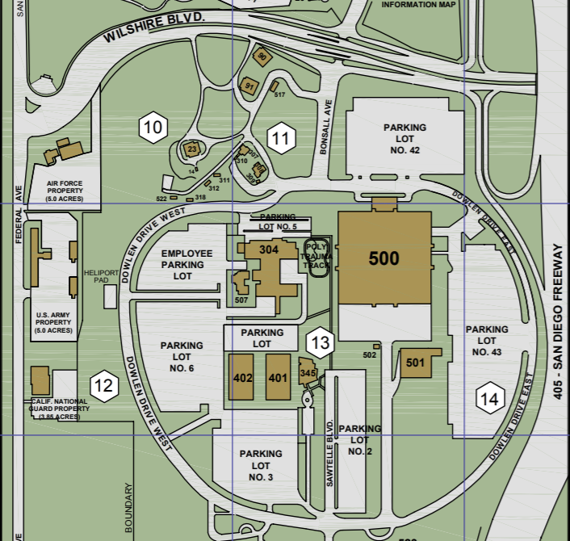
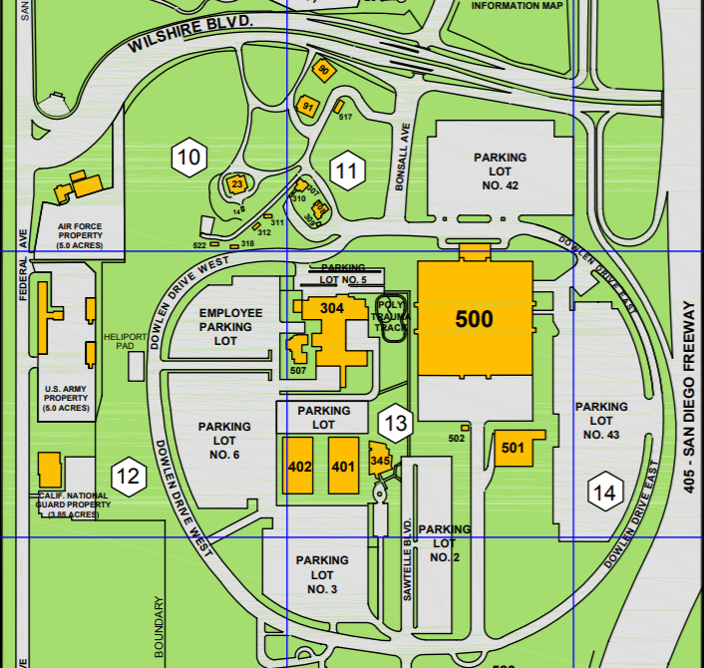


West Los Angeles VA Pre-Procedural COVID Testing: Patient Information
Dear Veteran,
The COVID-19 pandemic has caused changes to many aspects of daily life. The Greater Los Angeles VA remains committed to providing safe patient care. In order to provide the best care possible, your doctor has ordered a pre-procedure COVID test. You will receive a call to schedule a testing appointment 1-3 days before your procedure.
Please do not eat, drink, use mouthwash or chew gum within an hour of your appointment.
Follow signs for the Emergency Department to enter and park in Lot 42 or 43.
By the East Entrance of the main hospital (Building 500), you will find the Green Testing Tents 9 and 10 (the PST)
T
East Entrance of Building 500
When you arrive, a nurse will check you in and you will perform the nasal (nose) swab. The visit should take about 20 minutes.
If you develop COVID symptoms before your testing appointment, please call your case manager or doctor immediately.
Thank you for choosing GLA for your quality healthcare!
Main Building

